Slide 1

A Modem Testbed for Body Area Network (BAN) Communication
BIOTRONIK // CRM
Internship wrap-up presentation
Yifang Chen
Mentor: Brian Taff
8-Aug-2017
Feb 9th, 2017

Slide 2
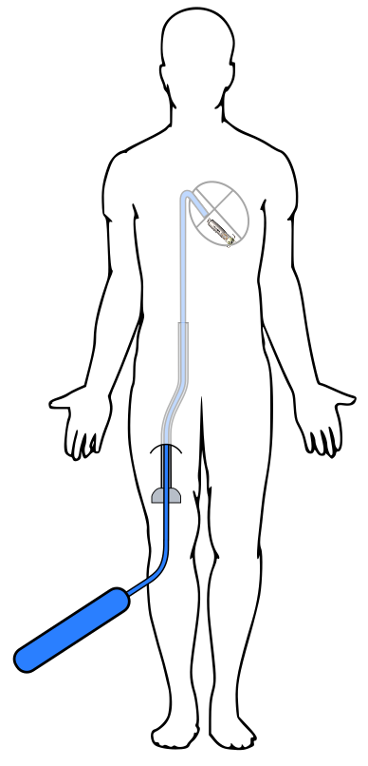
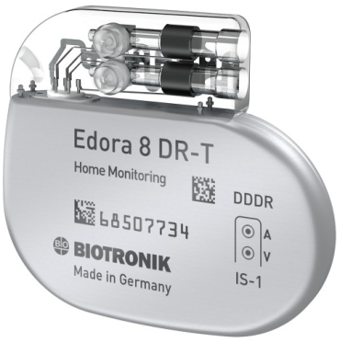
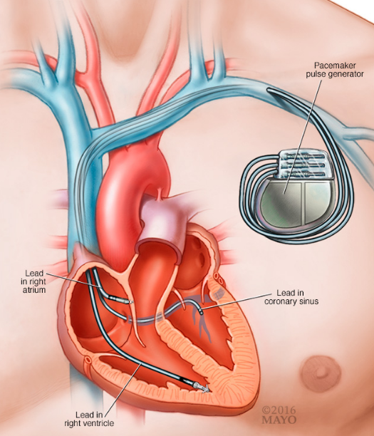
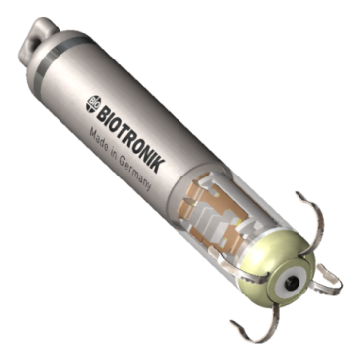
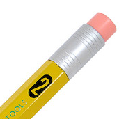
The present cardiac rhythm management (CRM) market
Traditional canned devices
Leadless pacing
Generator implanted in chest
Substantial scarring/bulge
Transvenous lead connections to heart
Infection risk
Extensive testing/design for MRI safety
Catheter-based implantation
No chest scar
Device implanted within heart
Minimized infection risk
Inherently MRI safe
The future
Notes:
60

Slide 3

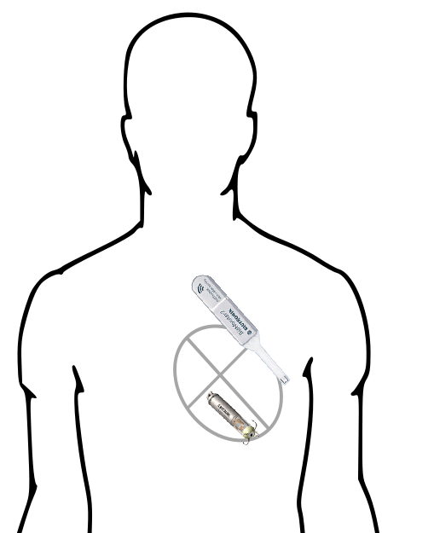
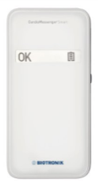
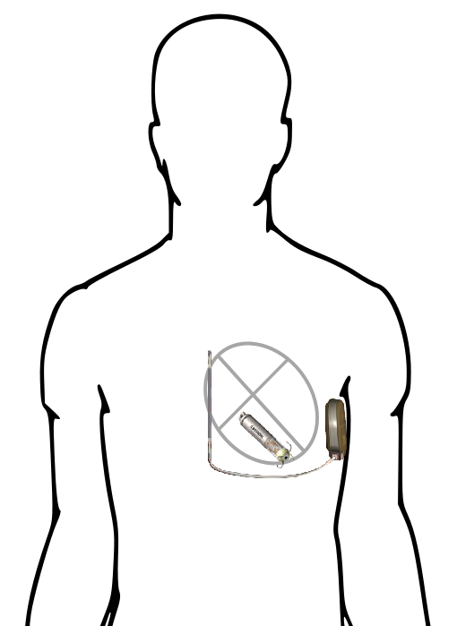
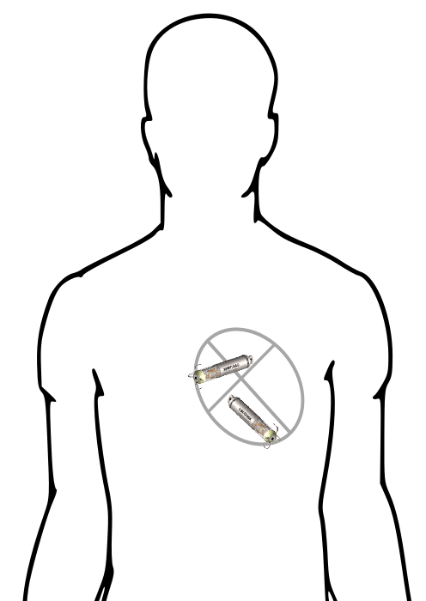

The value of BAN communication in CRM products
Multi-chamber leadless
Home monitoring (HMSC)
Anti-tachycardia pacing (ATP)
Beat-by-beat communication
Few bits, sent often
Enables synchronization of atrium and ventricle
More physiologic heart function
Leadless pacer stats relayed to web
Many bits, sent daily
Subcutaneous hub powers RF relay
Returns core canned
device functionality
Extends capabilities of new-generation defibrillators
Few bits, sent rarely
Less painful, low power means for halting some fatal rhythms
GSM
Atrium
Shock box
BAN
BAN
(Please pace)
RF
Ventricle
Leadless pacer
BAN
Sub-Q hub
(BM)
Notes:
60

Slide 4
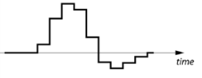
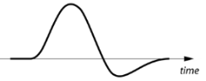
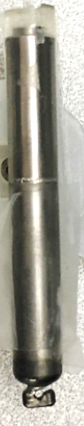
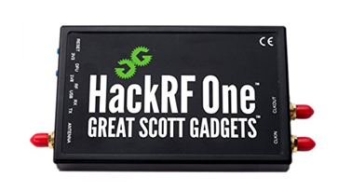
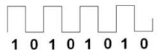


Project Overview
Digital
Analog
Motivation:
In order to assess the BAN communication for iLPs, under:
the different SW modem design templates, and
the different physical-layer infrastructures,
a new, configurable system, which is hardware-platform independent, is needed.
Data
Software-defined Radio Bench Modems
Acoustic
Galvanic
Transmitter
OR
Physical-layer test environment
Acoustic
Galvanic
Receiver
Data
Notes:
90s

Slide 5
Project Overview
Digital
Analog
Presentation outline:
Develop library of SW-defined radio modems
Build infrastructure for physical-layer testing
Collect test result
Summary and Possible Project Extension
Data
Software-defined Radio Bench Modems
Acoustic
Galvanic
Transmitter
OR
Physical-layer test environment
Acoustic
Galvanic
Receiver
Data
Notes:
90s

Slide 6

Project Overview
Digital
Analog
Outline:
Develop library of SW-defined radio modems
Build infrastructure for physical-layer testing
Collect test result
Summary and Possible Project Extension
Data
Software-defined Radio Bench Modems
Acoustic
Galvanic
Transmitter
OR
Physical-layer test environment
Acoustic
Galvanic
Receiver
Data
Notes:
90s

Slide 7
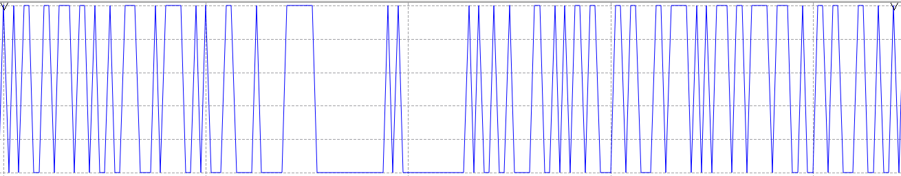
Develop library of SW-defined radio modems
Packet Encoder/Decoder
Signal Modulation/Demodulation
Interface to Transmitter/Receiver
A translator between human language and computer language
text ← → binary digits
A translator between computer language and physical world language
binary digits ← → physical wave
Tell the transmitter/receiver how I want to send/receive the modulated signal
Rx
Tx
Rx
Tx
Access code
‘hello
world’
Code to indicate the beginning of packet
The targeted text message
01001000 01100101 01101100 01101100 01101111 01110111 01101111 01110010 01101100 01100100
10101100…001 (varies)
ASK:
Amplitude shift
FSK:
Frequency shift
PSK:
Phase
shift
…
Notes:
90s:
1\why we need to develop a system?
2\workflow

Slide 8
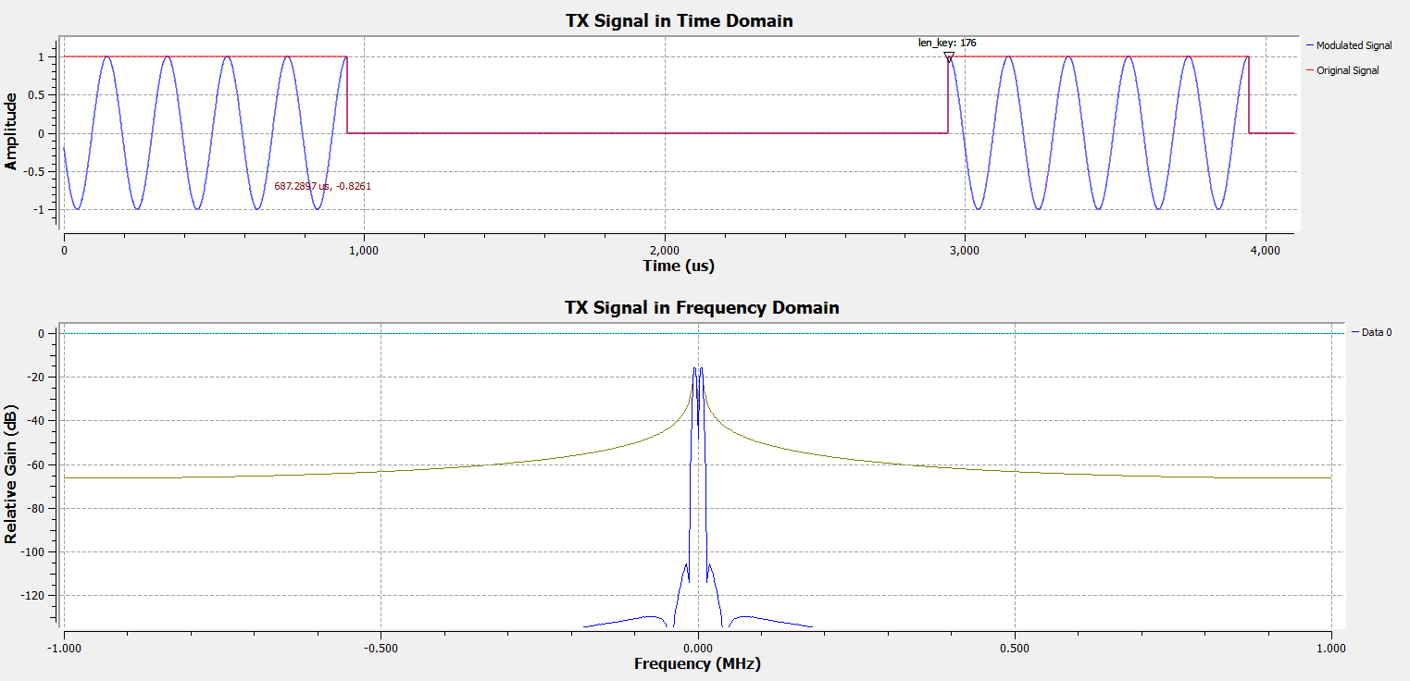
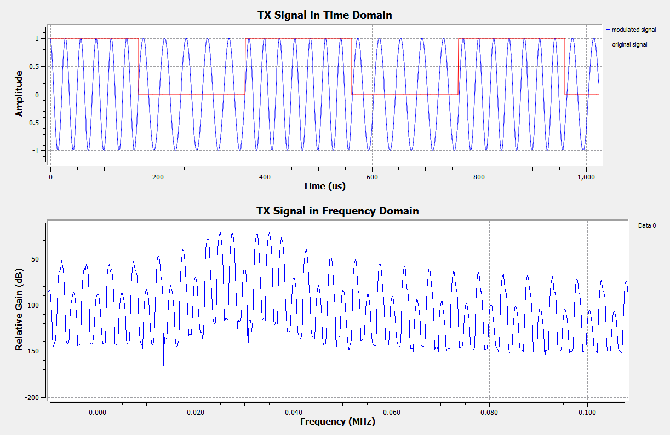
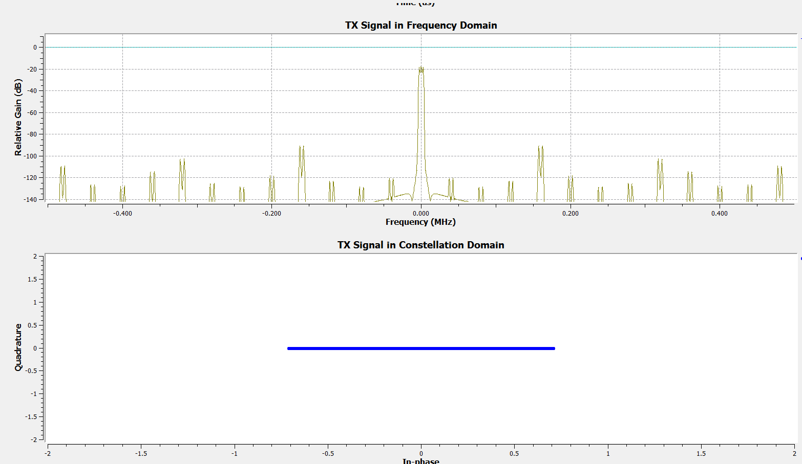
ASK
FSK
PSK
Time Domain
Time Domain
Constellation Domain
0
1
0
1
0
1
Frequency Domain
Frequency Domain
Frequency Domain
25KHz
35KHz
Amplitude Shift Key:
Bad noise immunity
Less bandwidth efficient
Simple design
Frequency Shift Key:
Good noise immunity
More bandwidth efficient
More complex design than ASK
Phase Shift Key:
Good noise immunity
Slightly more bandwidth efficient
More complex design than FSK
More Power Consumption
------------------------- binary digits 1,0
------------------------- modulated signal
Notes:
60s

Slide 9
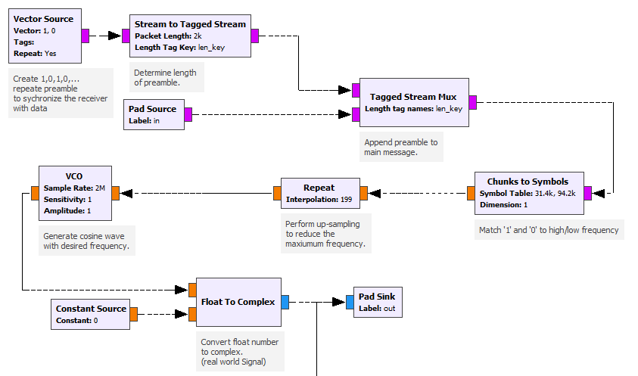
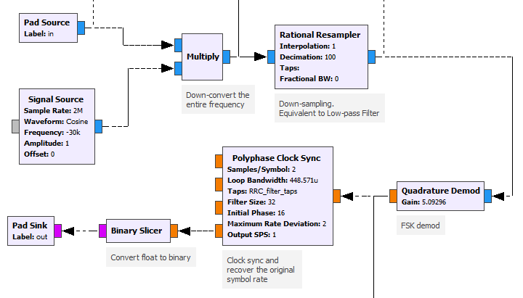
A deeper look into FSK
Modulation (TX)
De-modulation (RX)
Notes:
60s

Slide 10

A deeper look into FSK
Modulation(TX)
De-modulation (RX)
Notes:
Picture need to change; need VCO?

Slide 11
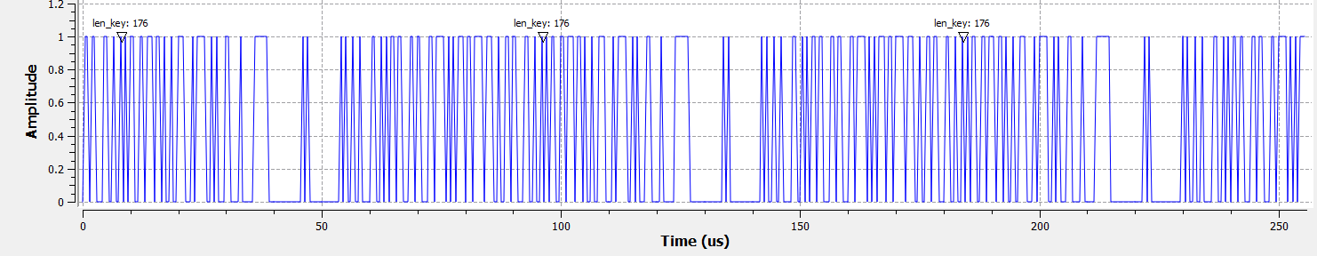
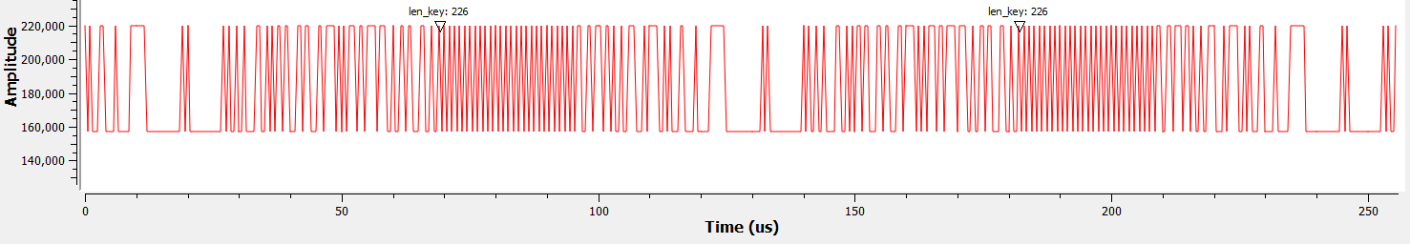

A deeper look into FSK
Modulation
De-modulation (RX)
Access code + “helloworld”
Message interval: only noise
Message interval: only noise
Receiver NOT prepared for sudden jump from noise to message
Fill empty interval with 101010… preamble sequence
Receiver prepared for receiving targeted message by 1010…
Message interval: only noise
Message interval: only noise
Notes:
30s

Slide 12
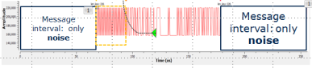
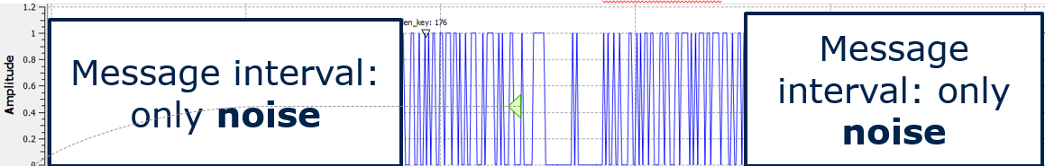

A deeper look into FSK
Modulation(TX)
De-modulation (RX)
Notes:
Picture need to change; need VCO?

Slide 13

A deeper look into FSK
Modulation(TX)
De-modulation (RX)
‘0’ → 25kHz
‘1’ → 35KHz
Notes:
Picture need to change; need VCO?

Slide 14

A deeper look into FSK
Modulation(TX)
De-modulation (RX)
Up-sampling:
Repeat each symbol X 200 times
‘0’ → 25kHz
‘1’ → 35KHz
Notes:
30s

Slide 15
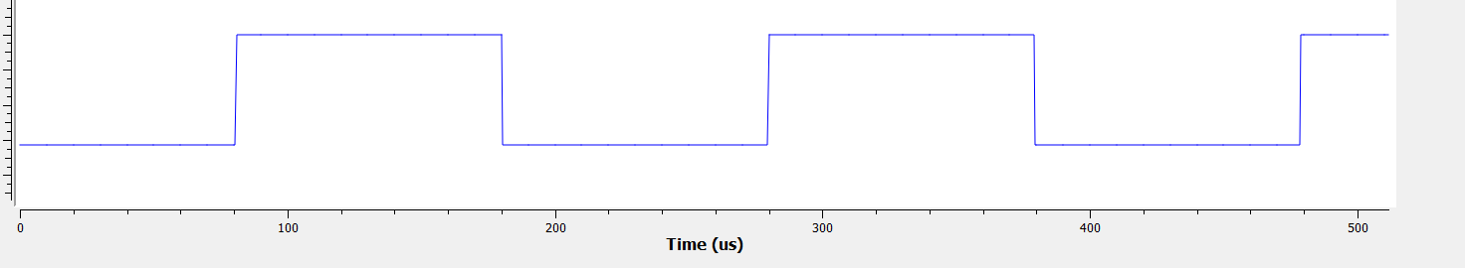

A deeper look into FSK
Modulation
De-modulation (RX)
Signal with 25K (0) and 35K (1) volts
Amplitude
35000
…
25000
Voltage Controlled Oscilloscope:
(1) Generate Cosine Waves; (2) Control its frequency using input voltage
1
0.5
0
-0.5
-1
Up-sampling:
Repeat each symbol X 200 times
‘0’ → 25kHz
‘1’ → 35KHz
Amplitude
Notes:
30s

Slide 16
A deeper look into FSK
Modulation(TX)
De-modulation (RX)
Up-sampling:
Repeat each symbol X 200 times
‘0’ → 25kHz
‘1’ → 35KHz
Notes:
30s

Slide 17
A deeper look into FSK
Modulation(TX)
De-modulation (RX)
Up-sampling:
Repeat each symbol X 200 times
‘0’ → 25kHz
‘1’ → 35KHz
Notes:
Picture need to change; need VCO?

Slide 18
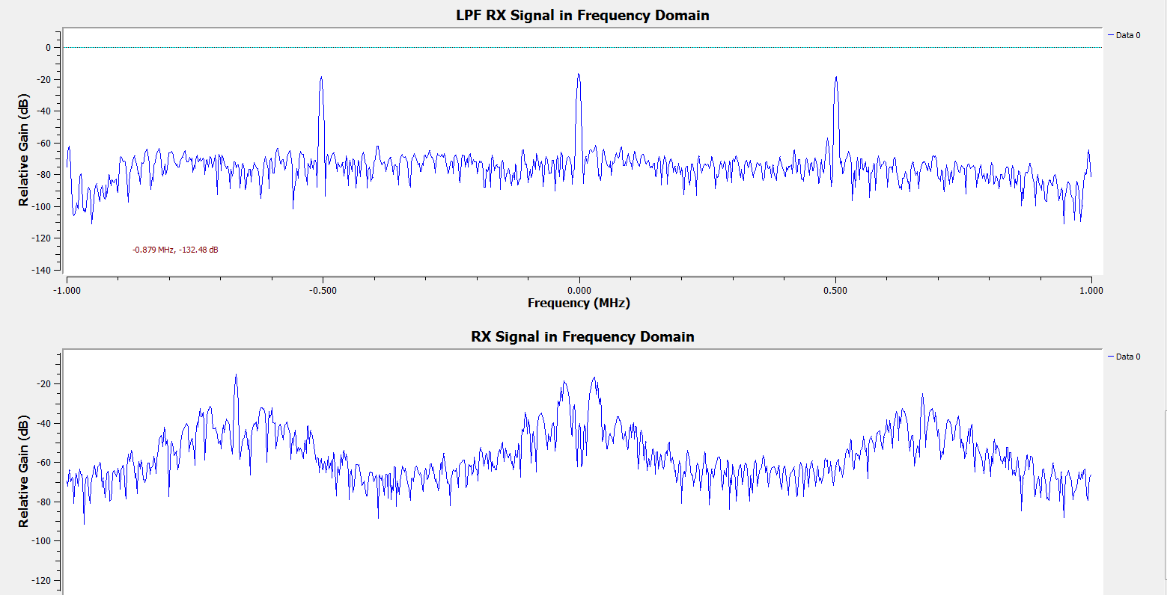
A deeper look into FSK
Received Signal in Frequency Domain
Modulation
De-modulation
noise
noise
Filtered out the high frequency noise
Down-sampling: /200
Low passed signal in Frequency Domain
Up-sampling:
Repeat each symbol X 200 times
0
DC offset (don’t matter)
‘0’ → 25kHz
‘1’ → 35KHz
1
(for better understand, here I use frequency domain instead od time domain before)
Notes:
30s

Slide 19

A deeper look into FSK
Modulation(TX)
De-modulation (RX)
Down-sampling:
/100
Up-sampling:
Repeat each symbol X 200 times
‘0’ → 25kHz
‘1’ → 35KHz

Slide 20
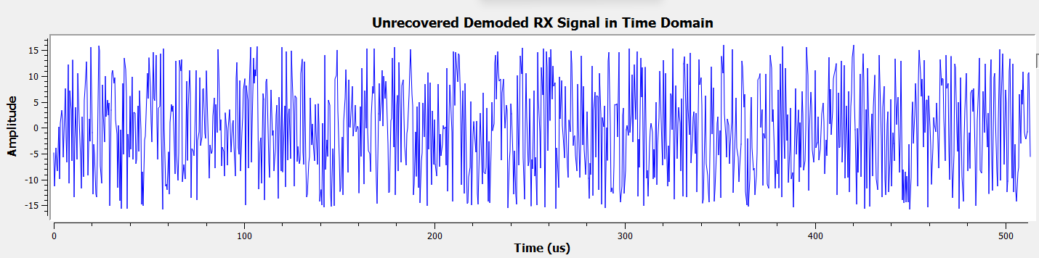
A deeper look into FSK
Modulation
Low passed signal in Frequency Domain
De-modulation
0
DC offset (don’t matter)
1
Down-sampling:
/100
35KHz ->positive value (1); 25KHz ->negative value (0);
Up-sampling:
Repeat each symbol X 200 times
Recovered Signal in Time Domain
‘0’ → 25kHz
‘1’ → 35KHz
Example here is 1,0,1,0,… signal sequence
Notes:
30s

Slide 21
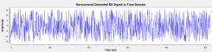
A Deeper Look into FSK
Modulation(TX)
De-modulation (RX)
Down-sampling:
/100
Up-sampling:
Repeat each symbol X 200 times
‘0’ → 25kHz
‘1’ → 35KHz
Notes:
Picture need to change; need VCO?

Slide 22
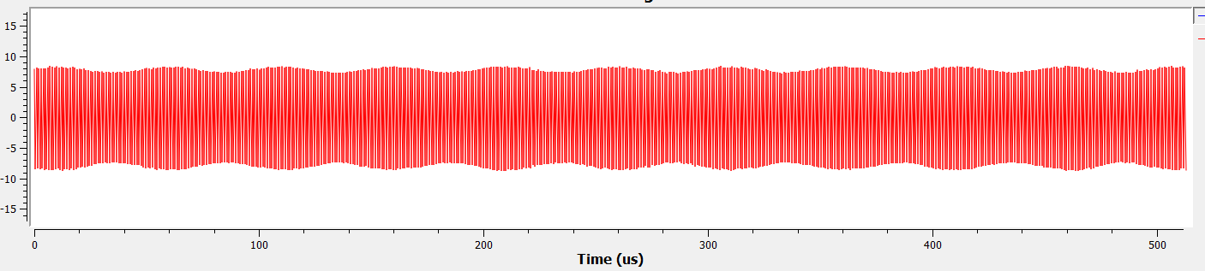
A Deeper Look into FSK
Recovered Signal in Time Domain
Modulation
De-modulation
Up-sampling:
/200
(1)Down-sample again:/2 to recover the original symbol rate
(2) Further Smooth the signal
Up-sampling:
Repeat each symbol X 200 times
Further Recovered Signal in Time Domain
‘0’ → 25kHz
‘1’ → 35KHz
‘0’ → 25kHz*2pi; ‘1’ → 35KHz*2pi
22
Example here is 1,0,1,0,… signal sequence
Notes:
Picture need to change; need VCO?

Slide 23
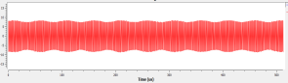
A Deeper Look into FSK
Modulation(TX)
De-modulation (RX)
Up-sampling:
/200
Up-sampling:
Repeat each symbol X 200 times
‘0’ → 25kHz
‘1’ → 35KHz

Slide 24
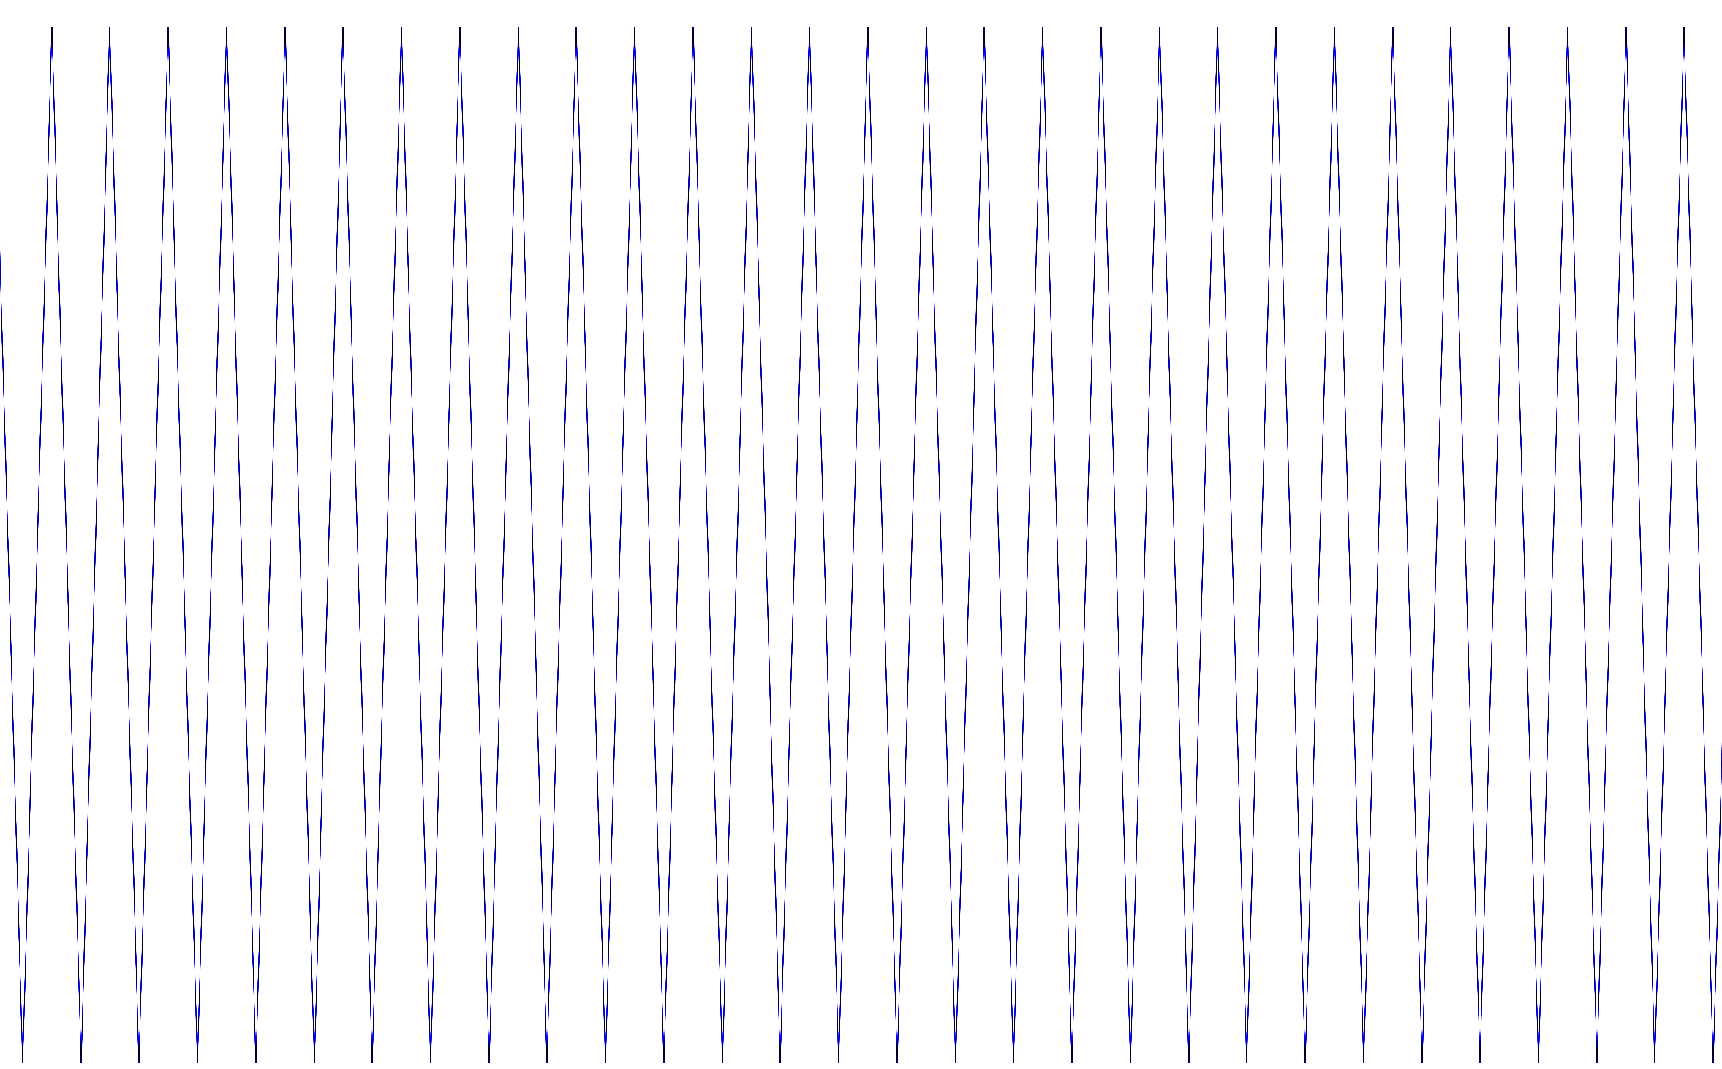
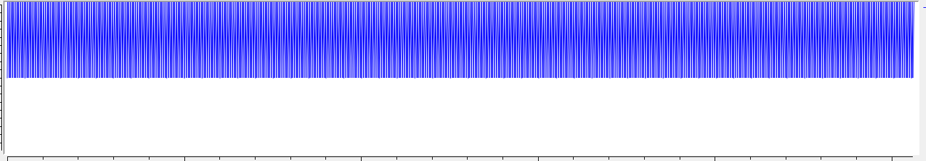
A Deeper Look into FSK
Modulation
De-modulation
1
Up-sampling:
/200
Truncate float to Binary:
positive →1; negative →0
0
Up-sampling:
Repeat each symbol X 200 times
‘0’ → 25kHz
‘1’ → 35KHz
/ 2
24
Example here is 1,0,1,0,… signal sequence
Notes:
20-23: 30s

Slide 25
Project overview
Digital
Analog
Presentation outline:
Develop library of SW-defined radio modems
Build infrastructure for physical-layer testing
Collect test result
Summary and Possible Project Extension
Data
Software-defined Radio Bench Modems
Acoustic
Galvanic
Transmitter
OR
Physical-layer test environment
Acoustic
Galvanic
Receiver
Data
Notes:
90s

Slide 26
Project overview
Digital
Analog
Presentation outline:
Develop library of SW-defined radio modems
Build infrastructure for physical-layer testing
Collect test result
Summary and Possible Project Extension
Data
Software-defined Radio Bench Modems
Acoustic
Galvanic
Transmitter
OR
Physical-layer test environment
Acoustic
Galvanic
Receiver
Data
Notes:
90s

Slide 27

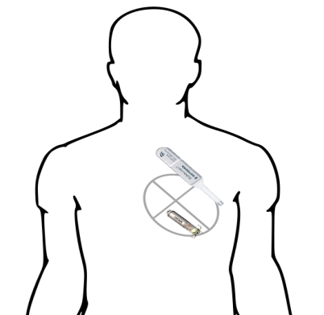

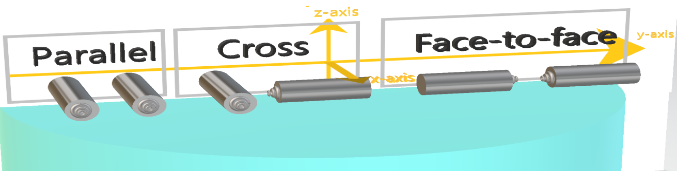
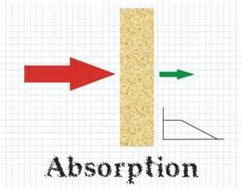
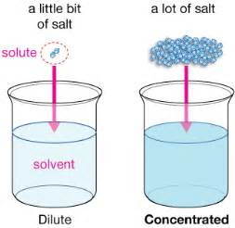
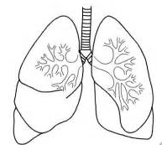
Physical testing environment
BAN Testing Parameters:
Distance: 40mm – 200 mm
Right Atrium (RA)
~70mm
Right Ventricle (RV)
BM chest
~140mm
Right Ventricle (RV)
Right Atrium (RA)
Right Ventricle (RV)
Right Atrium (RA)
~130mm
S-ICD
Or
Or
Orientation:
only needed in S-ICD case
Transmission Media:
Body Fluid Simulation:
Saline concentration = 2.0g/L; Conductivity 2.85mS/cm
Skin Simulation: Anechoic chamber (container surrounded by anechoic foam)
Air in lungs Simulation:
Using Balloon
salt
Notes:
90s

Slide 28
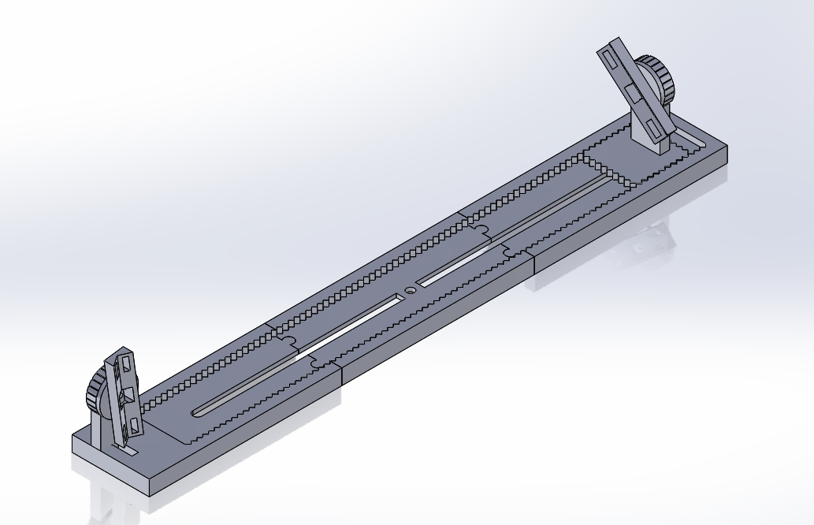
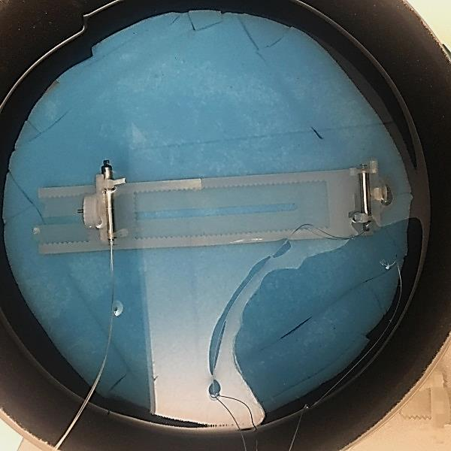
Physical testing environment
Device positioning fixture:
Enables stable device positioning
Actual use in saline tank

Slide 29
Project overview
Digital
Analog
Presentation outline:
Develop library of SW-defined radio modems
Build infrastructure for physical-layer testing
Collect test result
Summary and Possible Project Extension
Data
Software-defined Radio Bench Modems
Acoustic
Galvanic
Transmitter
OR
Physical-layer test environment
Acoustic
Galvanic
Receiver
Data
Notes:
90s

Slide 30
Project overview
Digital
Analog
Presentation outline:
Develop library of SW-defined radio modems
Build infrastructure for physical-layer testing
Collect test result
Summary and Possible Project Extension
Data
Software-defined Radio Bench Modems
Acoustic
Galvanic
Transmitter
OR
Physical-layer test environment
Acoustic
Galvanic
Receiver
Data
Notes:
90s

Slide 31
Outline for testing dual-chamber use case
Parameter Scope
Testing Values
Parameters
Acoustic
Rx/Tx iLP
Galvanic
1 Byte Message
HW Factors
Parallel
Orientation
Cross
1.Received packet percentage
Face-to-face
Distance
2.Bit Error Rate (BER) of received packets
100mm
Accuracy:
10 Byte Message
SW/Algorithm-factors
Modulation Methods
FSK
3.Estimated total Bit Error Rate
Total Required Bandwidth
20KHz
Environmental Factors
No noise
Noise
Noise (f = carrier + 9KHz)
Notes:
60s

Slide 32
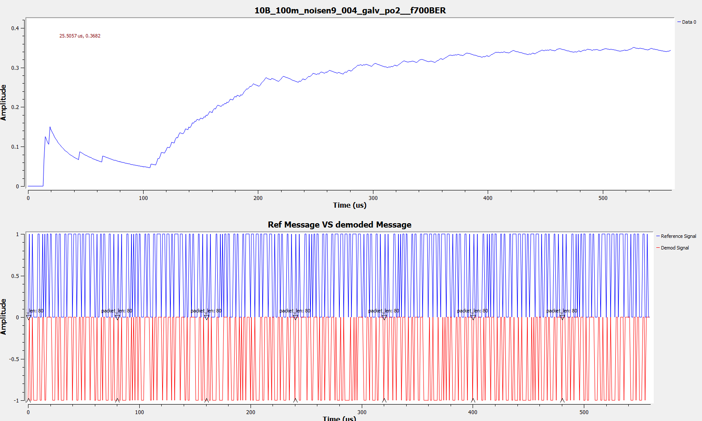
Testing Result – Screenshot example
Original Signal VS Demodulated Signal
“Hello World!”
TX
Bit Error Rate ~= 35%
RX
“H@llo Werld!”
Notes:
30s

Slide 33
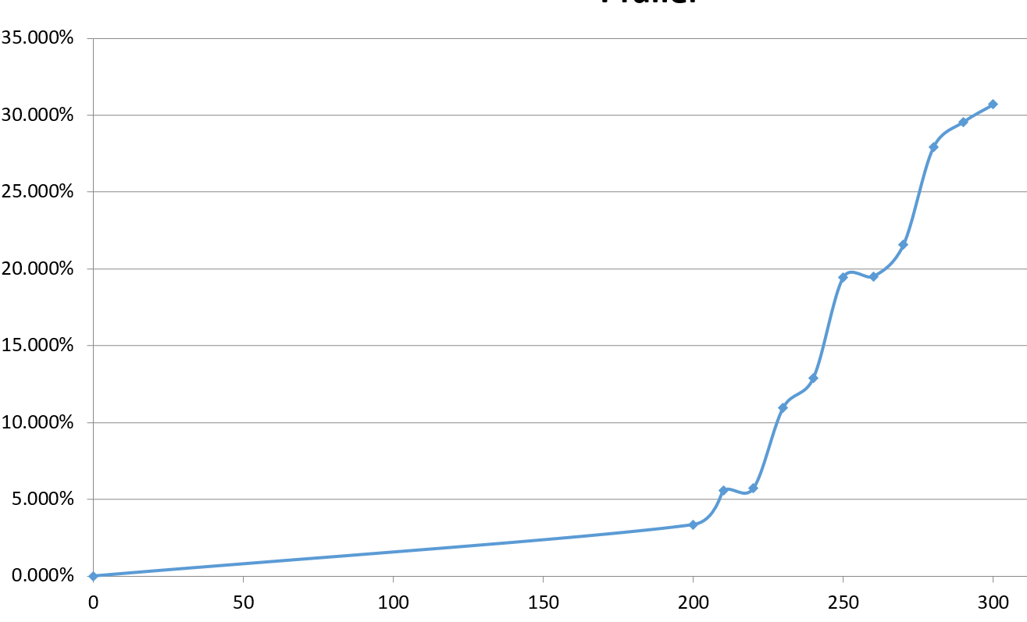
Preliminary test results using a galvanic physical layer
How does noise influence accuracy?
BER rises exponentially with increasing noise – for a fixed distance, location, and packet size
~200mV = max. permissible noise voltage for 1990KHz signal (signal amplitude ~= 1.54V)
Bit Error Rate
Noise voltage (mV)
Notes:
90s:
1\why we need to develop a system?
2\workflow

Slide 34
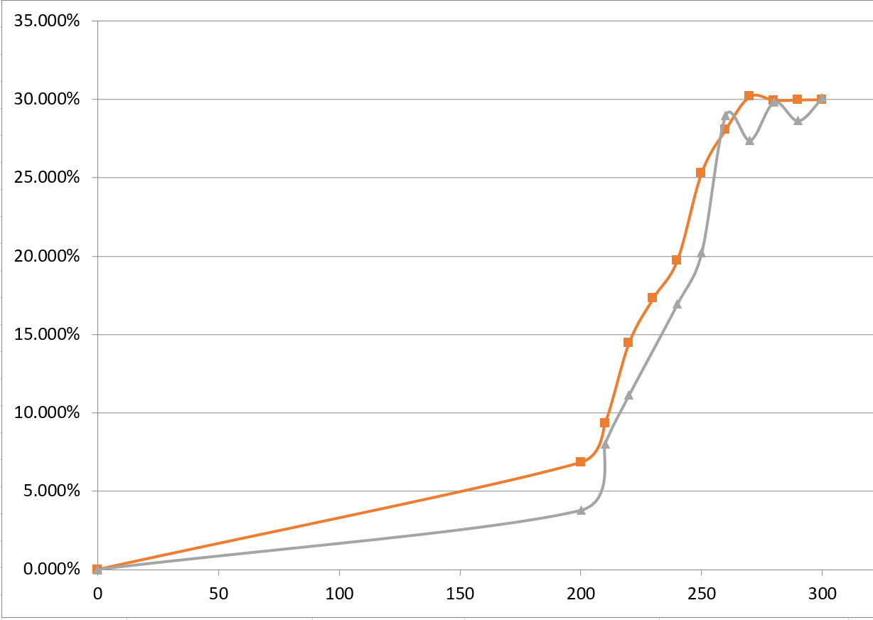
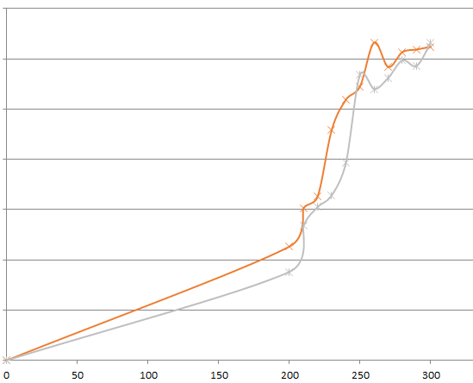
Testing Result – Parameters that influence Galvanic Accuracy
How orientation influence accuracy? (each series corresponds to a unique distance)
For face-to-face orientation, larger distance will give more accurate transmission at least in range around 100mm
Face-to-Face Orientation
Cross Orientation
-----: smaller distance (use middle as reference point)
Bit Error Rate
-----: larger distance (use head as reference point)
Noise voltage (mV)
Noise voltage (mV)
Notes:
90s:
1\why we need to develop a system?
2\workflow

Slide 35
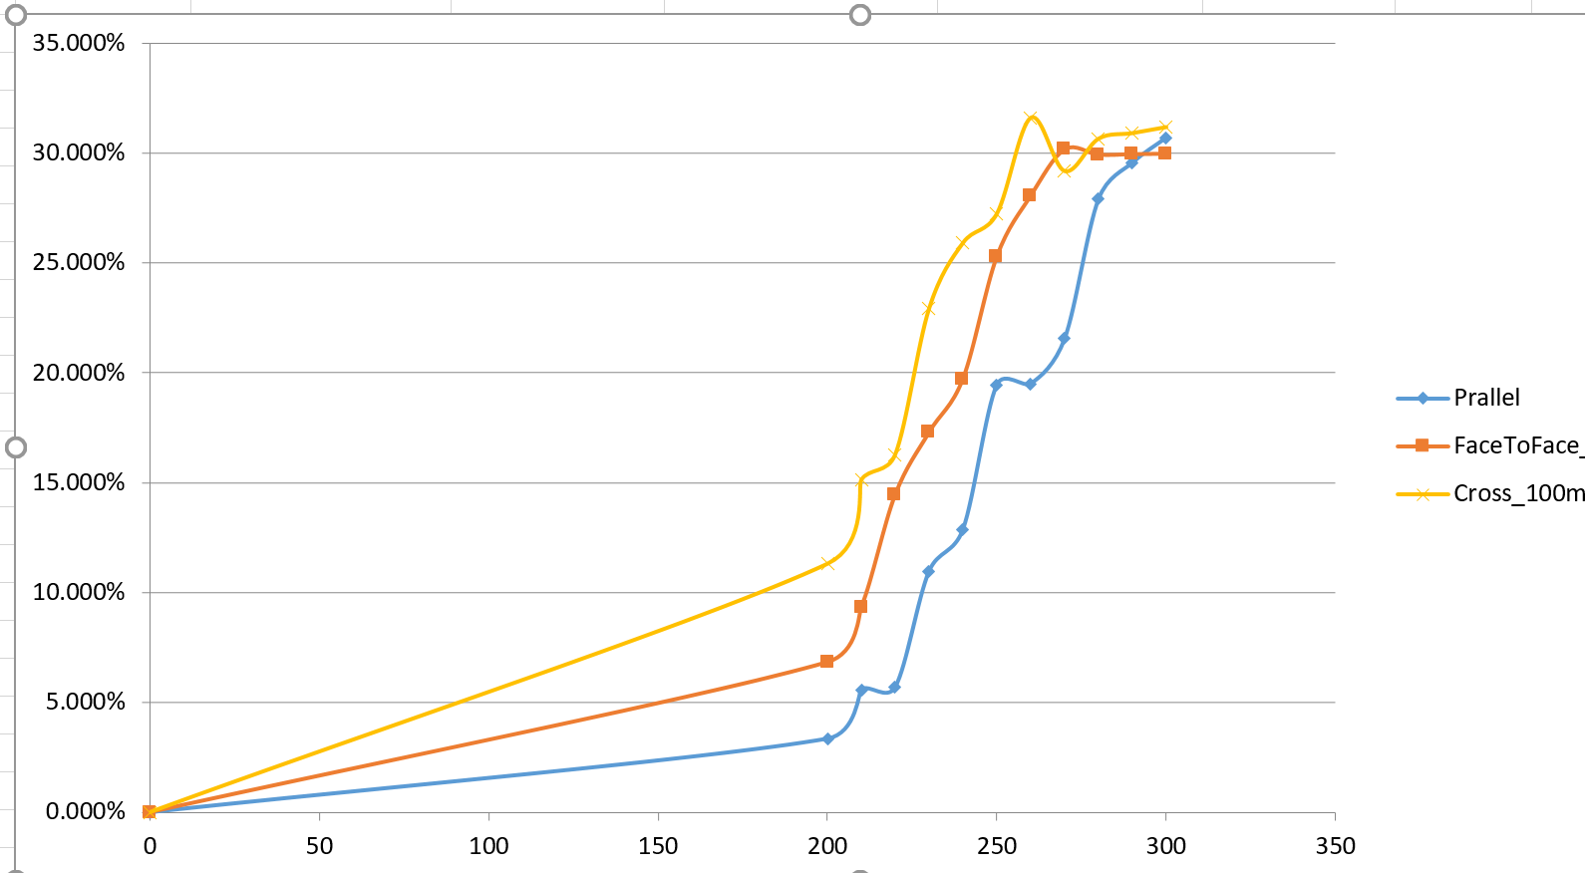
Preliminary test results using a galvanic physical layer
How does orientation influence accuracy?(each series corresponds to each orientation)
General trend for improved data transception: Parallel > Face-to-face > Cross
Bit Error Rate
-----: Cross
-----: Face-to-Face
-----: Parallel
Noise voltage (mV)
Notes:
90s:
1\why we need to develop a system?
2\workflow

Slide 36
Summary
Provided SDD with a new configurable tool for assessing BAN modem design templates and performing comparative testing of physical layer communication technologies
Includes code (SW in GNU radio) that is readily portable to more mature test hardware (i.e. National Instruments vs. HackOne RF)
Interfaces with a saline test environment capable of mimicking a multitude of BAN communication use cases
Begin preliminary testing that should ultimately facilitate the first “apples to apples” comparisons of in-house SDD physical layer communication methodologies
Documented my development and design efforts to enable support for continued system-level benchmarking after my tenure
Notes:
30s

Slide 37
Possible project extensions
Further improve the assessment system
Develop additional modulation templates inclusive of PPM
Transform the high-level SDR system into FPGA language to better assess Tx/Rx efficiencies
Transition targeted design blocks to analog implementations to better mimic envisionable implant module embodiments
Collecting more testing data
Explore full suite of developed modem formats and their impact on Tx/Rx accuracy
Obtain better insight on the role that distance and orientation play
Extract power efficiency metrics to shed light on design trade-offs

